Slide 1
Pathfinder Player Tool
Models, Data Dictionary, and Analysis
David Cindric
Matthew Johnson
18, September 2014
Slide 1

Slide 2
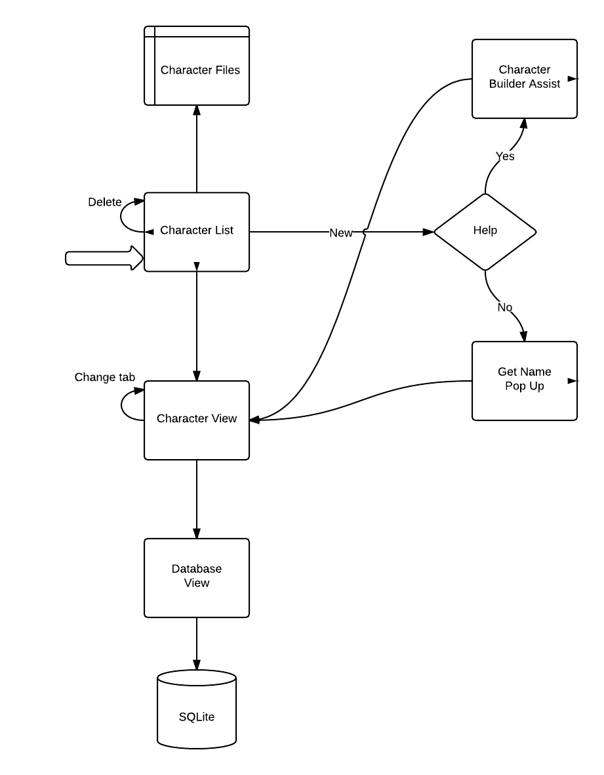
Process Model
Start
Slide 2

Slide 3
Data Definitions
Character: Encapsulates all information about the character. Contains name, race, description, and other relevant details.
Spell: Contains the name of the spell and a description of what it does along with other valuable information such as spell level.
Feat: Contains the description of the feat and the requirements to acquire
Armor/Weapon: Contains the name of the item along with damage and armor class.
Abilities: Contains the characters attributes. Strength, Intelligence, etc…
Special Ability: Contains description of a special ability certain characters may have
Skills: Contains names and descriptions of skills a character possesses. Ex: Acrobatics, Diplomacy, etc…
Slide 3

Slide 4
Data Model
Slide 4

Slide 5
Design Choices -Character Storage
Serialized Object IO
Provides easy access to all information
Supplies all information in a single object
Easier to work with programmatically
Databases
Provides more structure
Support for indexing, resulting in faster load times for subsets of the data
Can supply partial information
Allows for better memory management through partial loading of data
Slide 5

Slide 6
Design Choices -Social Features
Bluetooth
Available on practically all Android devices
Low range
Wi-Fi Direct
Only available on devices that have been released very recently
Fast transfer speeds and longer range than Bluetooth
GPS
Allows players to find nearby users of the application
Requires the use of a dedicated server to handle requests
Cloud Sync
Characters can be shared between two users anywhere in the world
Requires the use of a dedicated server, as well as storage for character uploads
Slide 6

Slide 7
System Analysis and Design Constraints
Processor Time Management
When are calculations performed?
Perform calculations ahead of time and store in memory, or repeatedly perform them when the result is required?
How often is the character saved?
Saving too often could lower the overall responsiveness of the UI
Saving too rarely could cause a potential loss of information
How often are Wi-Fi direct or Bluetooth used?
Are other users constantly being searched for?
Should the player choose when to look for others to share his character with?
Slide 7

Slide 8
System Analysis and Design Constraints
Memory Management
As a character grows, so does the amount of memory used
May be implausible to keep even a single character loaded in memory
Application must load very quickly
Power Management
Application must be able to handle the phone being put to sleep constantly as players pick it up to add a single data entry before putting it down again
Application may be running in the background for a long period of time, so background processing must be kept to a minimum
Slide 8

Slide 9
Algorithms and Calculations
Player Ability Modifiers
Must be able to dynamically change ability modifiers as gear is added or removed
Items can affect a players abilities and can compound with each other
Combat Rolls
Calculate combat rolls based on all modifiers
Must account for what modifiers are relevant to the situation, based on the character
Dynamically managing memory
Character may have too much information to keep everything loaded
Calculating relative weights of items to determine what to keep visible
Slide 9

